Slide 1
COVID safety for gyms and exercise studios
Communication toolkit for peak bodies and businesses
December 2021

Slide 2
Purpose of this pack
The COVID-19 pandemic is not over but the way we navigate it is changing. The NSW Government is focused on keeping the NSW community safe and businesses open so we can get the economy booming again.
As more people head back to the gym, this information pack has been prepared to help gyms, exercise studios and places with workout facilities prepare to welcome guests in a COVID safe way.
This pack includes tailorable content including newsletter/web copy, social media assets and posters to help communicate with businesses, staff and members/visitors.
For the latest updates, please continue to check nsw.gov.au. Translated information is available through Multicultural Health services.
Thank you for your ongoing support to help protect the NSW community and keep our economy open.

Slide 3
Newsletter/website copy: Peak bodies to businesses
Keeping our gyms and members COVID safe
As we learn to live with COVID-19 in our community there are things all owners and operators can do to protect staff and members to ensure our industry can thrive again. The nature of gyms mean that there is a higher risk of transmission so it’s important that our industry remains extra vigilant. There are three ways you and your business can support COVID safety.
1. Help protect your staff and guests
Encourage your staff and members to get fully vaccinated and a booster six months after their second vaccination. Remind them to wash and sanitise their hands before a session, bring their own towel and mat to each workout and keep a distance from others where possible. Wearing a mask indoors can also provide extra protection.
2. Reduce the risk
Ensuring members wipe down all machines and equipment after use, regular cleaning and improving indoor ventilation or filtration can all help reduce the risk of transmission. Useful cleaning resources, including information about how to clean if a COVID-19 case visits your premises, can be found from SafeWork Australia and the Department of Health.​
3. Limit the spread
Remind your staff and members to be alert for symptoms and not to visit your premises if they are feeling unwell. They should get tested and isolate until they receive a negative result – even if they are fully vaccinated. Ensuring all guests check in via the NSW Government QR code will help contain any transmission that may occur.
Together it's up to all of us to stay COVID safe, protect our community and our industry. Stay up to date with the latest information at nsw.gov.au

Slide 4
Email/website copy: Businesses to members / visitors
Keep your workout COVID safe
We are open with measures in place to ensure your workout is COVID safe. Working together we can ensure that we help protect you, our members and our staff.
How you can help
Protect yourself. Wash or sanitise your hands before and regularly throughout your workout. To limit contact with others, bring your own mat, water bottle and towel. Also bring your mask and wear it when you can. It protects you and those around you. It may be mandatory in some places so check the rules when you enter. Keep up your protection against COVID-19 by getting a booster vaccine if it's more than six months since your second vaccination.
Reduce the risk of transmission. Keep your distance from other people where possible and wipe down any machines and equipment after each use.
Limit the spread. If you're feeling unwell, please do not visit us. You will need to get tested and follow the health advice. You are still required to check in and out using the NSW Government QR code.
We look forward to seeing you soon and remember it's up to all of us to stay COVID safe. To learn more and stay up to date with the latest information, visit nsw.gov.au
Click here to download email signatures

Slide 5
Posters: Gym / studio premises
Click here to download posters

Slide 6
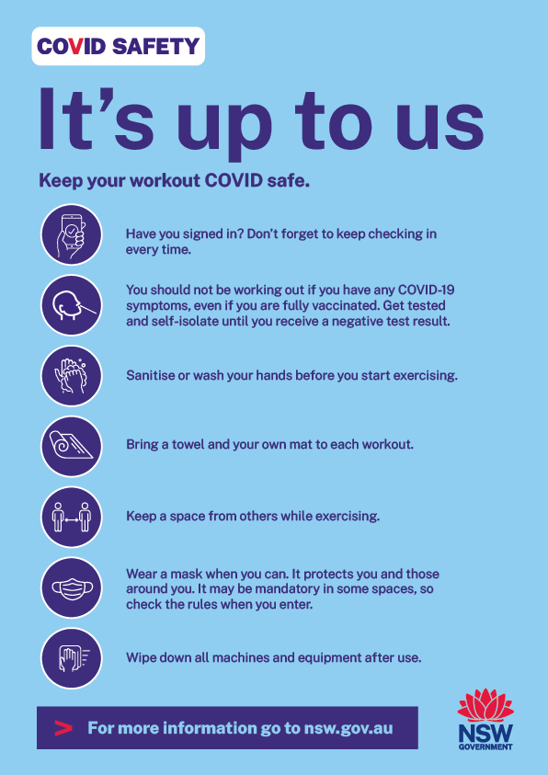
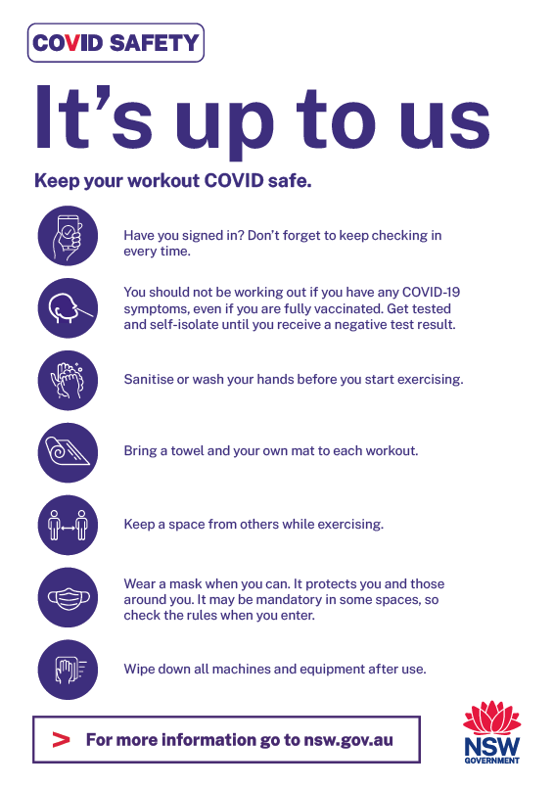
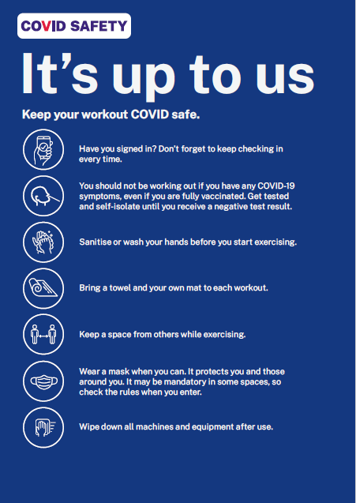
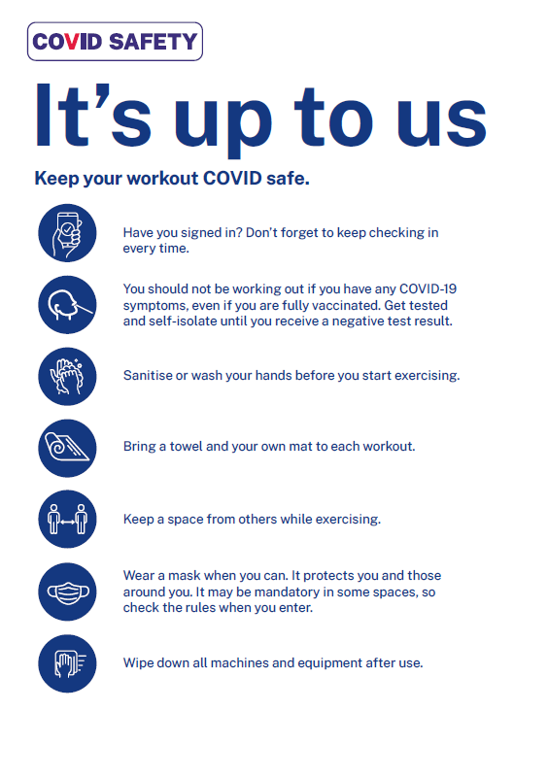
Flyers: Businesses to members / visitors
Click here to download A4 and print-ready versions
ADD YOUR LOGO HERE
ADD YOUR LOGO HERE

Slide 7
Posters: Add your own image and logo
Instructions:
Download the template by clicking here
Open the file in your usual image editing software. Add your own photo as a background
Add your own logo in the bottom right-hand corner
Finalise your poster.
+
=
ADD YOUR LOGO HERE
ADD YOUR LOGO HERE

Slide 8
Social assets: COVID safe behaviours
Click here to download social tile
Click here to download social tile
Click here to download social tile
Post: Be alert for symptoms before you head to the gym – even if you are fully vaccinated. If you're feeling unwell, please do not visit our premises. You will need to get tested and follow the health advice. Find out more at nsw.gov.au
Post: Heading to the gym? These are simple steps you can take to help keep yourself, other customers and staff COVID safe. Find out more at nsw.gov.au
Post: Keep your workout COVID safe by bringing your own towel and mat. It’s up to us to keep ourselves and our community COVID safe. Find out more at nsw.gov.au

Slide 9
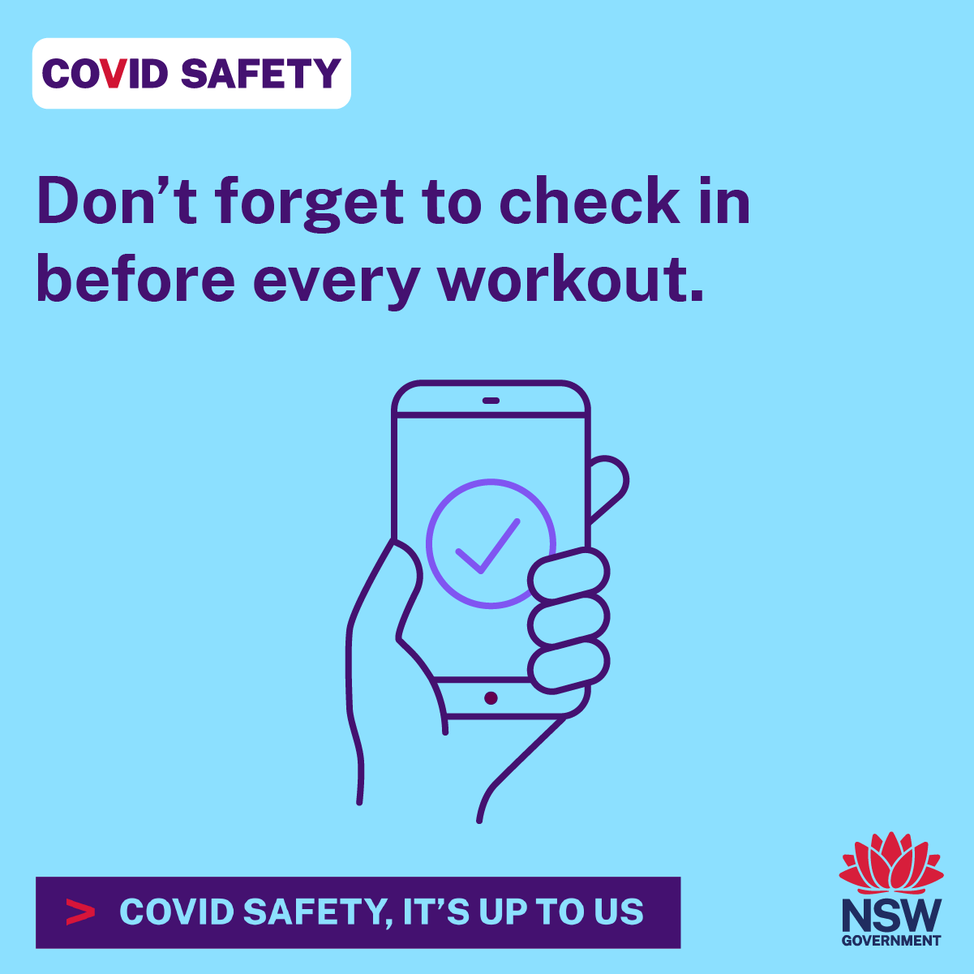
Social assets: COVID safe behaviours
Click here to download social tile
Click here to download social tile
Click here to download social tile
Post: Heading to the gym? You are still required to check in and out using the NSW Government QR code every time you visit. It’s up to us to keep ourselves and our community COVID safe.
Post: Reduce the risk of COVID transmission by keeping your distance from other people where possible when exercising. It’s up to us to keep ourselves and our community COVID safe. Find out more at nsw.gov.au​
Post: Keep up your protection against COVID-19 by getting a booster vaccine if it's more than six months since your second vaccination. It’s up to all of us to help keep our community COVID safe. Learn more at nsw.gov.au​

Slide 10
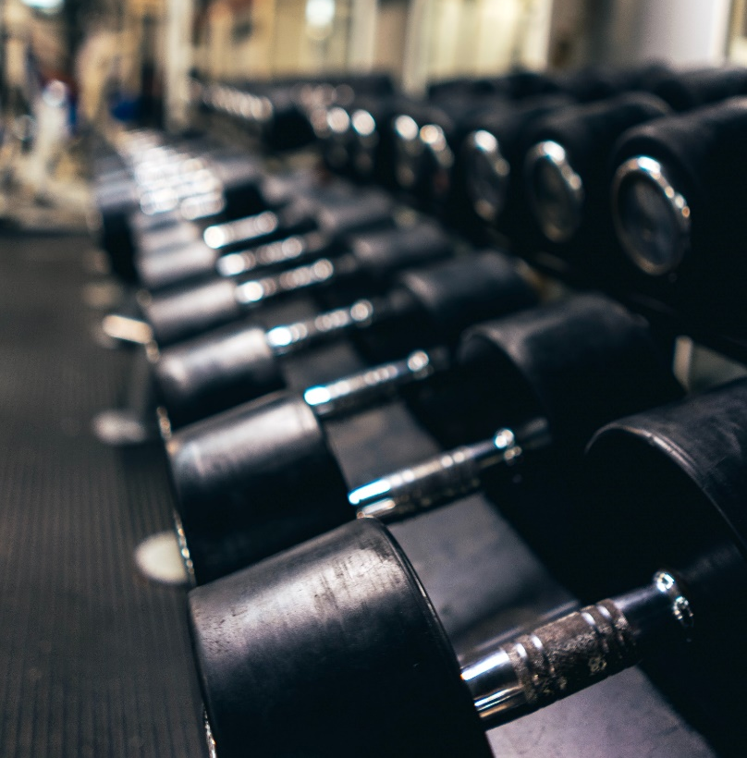
Social content: Add your own image and logo
Instructions:
Download the template by clicking here
Open the file in your usual image editing software. Add your own photo as a background
Add your own logo in the bottom right-hand corner
Save your image and upload to your social media channels
In your social post text, you can direct your audience to visit nsw.gov.au to learn more on COVID safety.
ADD YOUR PHOTO
+
=
ADD YOUR LOGO HERE

